Slide 1

SONAR ANALYSIS
USING JENKINS

Slide 2
Sonar Analysis
SonarQube is a code analysis tool used for analyzing the quality of code.
SonarQube is used to find the number of bugs, duplications, security vulnerabilities, and many more.
SonarQube can scan multiple programming languages, like Python, Java, and many more.
This tool is used by various organizations to detect potential bugs and issues.
Based on the report, developers can make changes in the code to fix potential errors and issues.
we can say SonarQube is a powerful tool used for maintaining the quality of code and helping organizations deliver high-quality software.

Slide 3
Jenkins
Jenkins is a tool that is used for automation.
It mainly allows all the developers to build, test and deploy software.
Jenkins facilitates the automation of several stages of the software development lifecycle, including application development, testing, and deployment.
The development, testing, and deployment of software applications are automated using CI/CD pipelines.
Sonar analysis using Jenkins can be done using necessary plugins; in the tools by adding the JDK, maven and sonar installations; and also by adding credentials the sonar analysis can be done to identify the bugs, duplications, also the security vulnerabilities.

Slide 4
SonarQube Jenkins Integration
Steps:
Launch an EC2 instance – selecting the AMI as ubuntu, naming the instance, opt for a t2.large instance, also select the keypair, in the network settings allow the ssh, http & https also add the security group role – all TCP and all traffic.
Then connect to the instance – either Git, Putty or MobaXterm any of these
Run the following commands to install java, maven and Jenkins—
sudo apt update –y
sudo apt upgrade –y
sudo apt install openjdk-17-jdk
Java –version

Slide 5
sudo apt install maven –y
sudo wget -O /usr/share/keyrings/jenkins-keyring.asc \
https://pkg.jenkins.io/debian-stable/jenkins.io-2023.key
echo "deb [signed-by=/usr/share/keyrings/jenkins-keyring.asc]" \
https://pkg.jenkins.io/debian-stable binary/ | sudo tee \
/etc/apt/sources.list.d/jenkins.list > /dev/null
sudo apt update
sudo apt install -y Jenkins
jenkins –version
mvn –version
sudo systemctl start Jenkins
sudo systemctl status Jenkins
sudo cat /var/lib/jenkins/secrets/initialAdminPassword

Slide 6
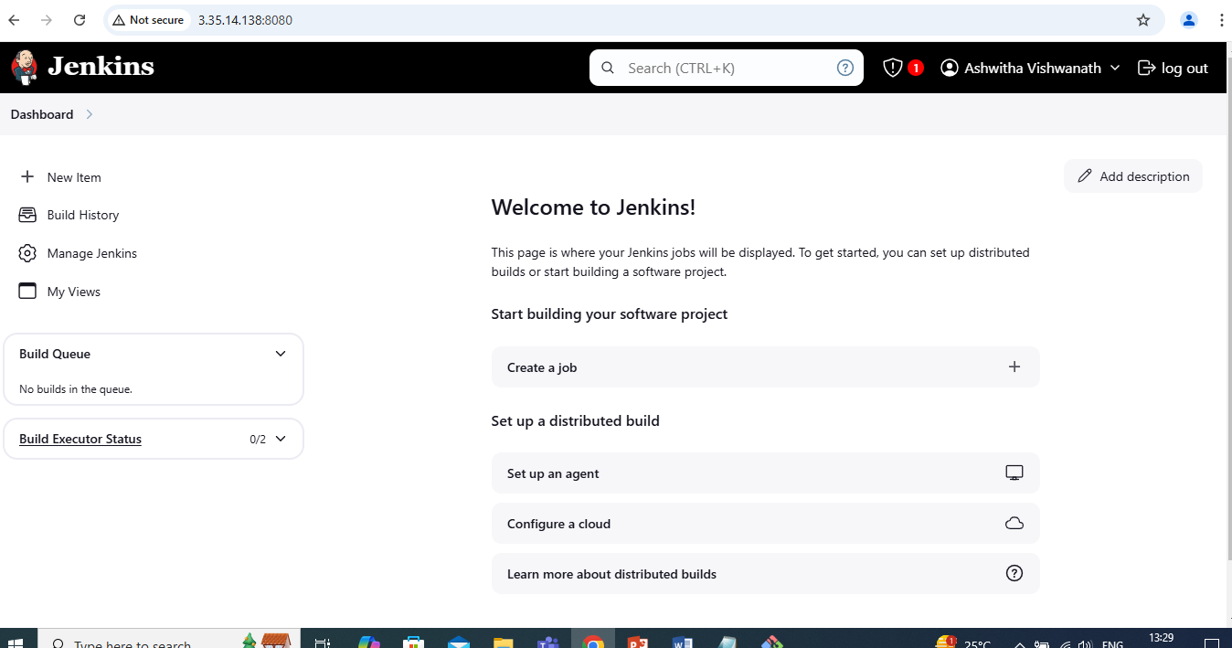

Slide 7
After sign in of jenkins dashboard to change port --
Sudo systemctl stop Jenkins
sudo systemctl status Jenkins
cd /etc/default
sudo vi jenkins -- In this file change the port HTTP_PORT:8090 and save giving :wq
cd /lib/systemd/system
sudo vi jenkins.service – In this file change theport JENKINS_PORT:8090 and save
sudo systemctl daemon-reload
sudo systemctl restart jenkins
unlock jenkins using 8090 port i.e., give the publicIP:8090 in the browser

Slide 8
Need to Install Docker Instance and connect to the sonarQube with Docker Container
sudo apt-get update
sudo apt-get install docker.io –y
sudo usermod -aG docker $USER
newgrp docker
docker run -d --name sonar -p 9000:9000 sonarqube:lts-community
Then in the browser using the publicIp:9000 connect to the sonarqube dashboard
To login to the sonarqube dashboard enter both the username and password as admin and change the password

Slide 9
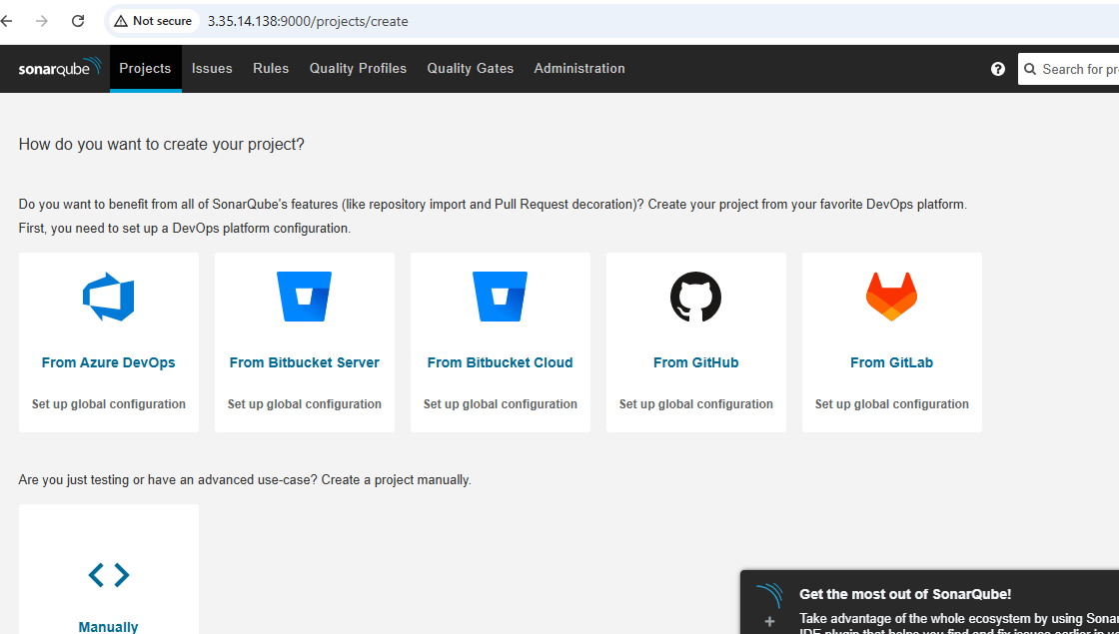

Slide 10
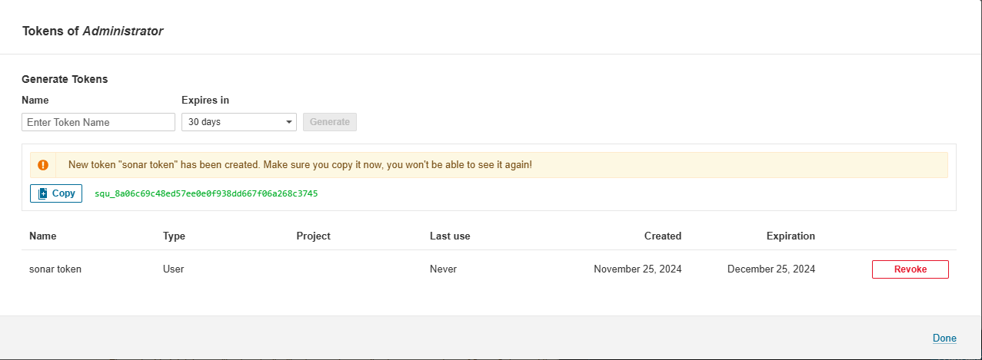
In the Jenkins dashboard, which is signed in with the port 8090 :
Install the necessary plugins which are Eclipse Temurin Installer, sonarqube scanner,
docker, kubernetes.
In tools add JDK and maven installations
Create a new project name it and select pipeline
Provide the description and the pipeline script
In the sonar dashboard, create a token name it and generate

Slide 11
In the Jenkins dashboard, manage Jenkins– paste the copied token in the credentials i.e., add the credentials also add the docker in the credentials.
Then in the manage Jenkins – system – add the server URL of the sonarqube installations also name and add the token which is added in the credentials
Again in the sonarqube dashboard, create webhook
Administartion → configuration → webhooks follow this path to create a webhook by naming it and add the URL of the Jenkins dashboard
Then build the pipeline to identify the bugs, duplications…

Slide 12
